Slide 1
Cost of Living Analysis Thakur Aryan singh

Slide 2
ABSTRACT
This project revolves around the analysis of the cost of living in various cities and countries across the globe. The dataset used for this analysis encompasses a wide range of economic indicators, from the price of basic commodities to the cost of housing, transportation, and even entertainment. By harnessing the power of Power BI, we aim to gain valuable insights into the economic disparities between different regions and understand the factors that contribute to the varying costs of living. This project serves as an exercise in data visualization, analysis, and interpretation, offering a comprehensive view of the world' s economic landscape

Slide 3
PROBLEM STATEMENT
The cost of living is a crucial metric that impacts individuals and businesses alike. Understanding the cost of living in different cities and countries is vital for making informed decisions regarding relocation ,investment, or business expansion. This project aims to address several key questions:
• What are the cities and countries with the highest and lowest costs of living?
• What are the major cost components contributing to the overall cost of living in a region?
• How do factors like average salary, housing costs, and transportation expenses correlate with the cost of living?
• Are there any trends or patterns in the data that can help individuals and organizations make strategic decisions?

Slide 4
DATASET DETAILS
The dataset consists of the following variables:
• City: Name of the city.
• Country: Name of the country.
• Column Description
• city Name of the city
• country Name of the country
• x1 Meal, Inexpensive Restaurant (USD)
• x2 Meal for 2 People, Mid-range Restaurant, Three-course (USD)
• x3 Mc Meal at McDonalds (or Equivalent Combo Meal) (USD)
• x4 Domestic Beer (0.5 liter draught, in restaurants) (USD)
• x5 Imported Beer (0.33 liter bottle, in restaurants) (USD)
• x6 Cappuccino (regular, in restaurants) (USD)
• x7 Coke/Pepsi (0.33 liter bottle, in restaurants) (USD)
• x8 Water (0.33 liter bottle, in restaurants) (USD)
So on………..till x55

Slide 5
Steps involved
Data Import and Preparation
Data Cleaning
Data Transformation
Exploratory Data Analysis (EDA)
Comparative Analysis

Slide 6
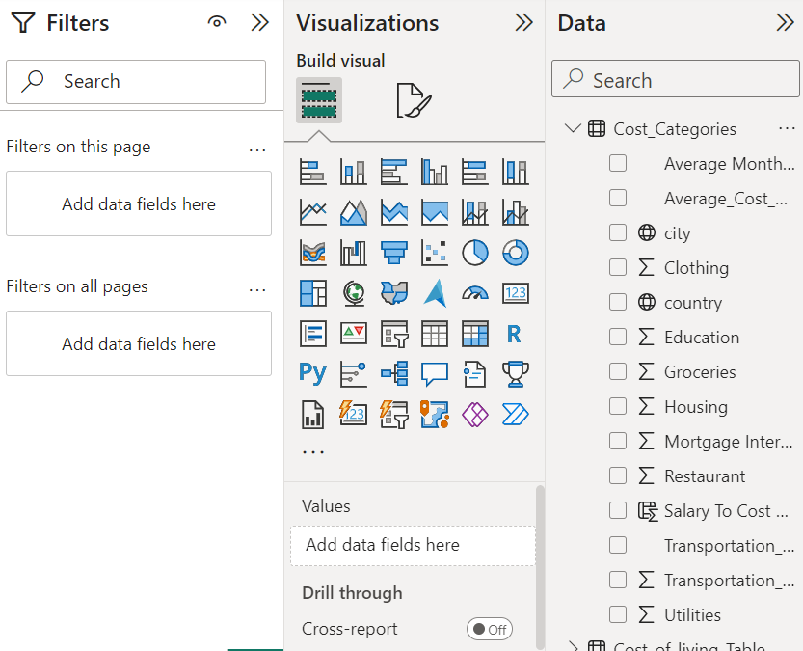
Tools used

Slide 7
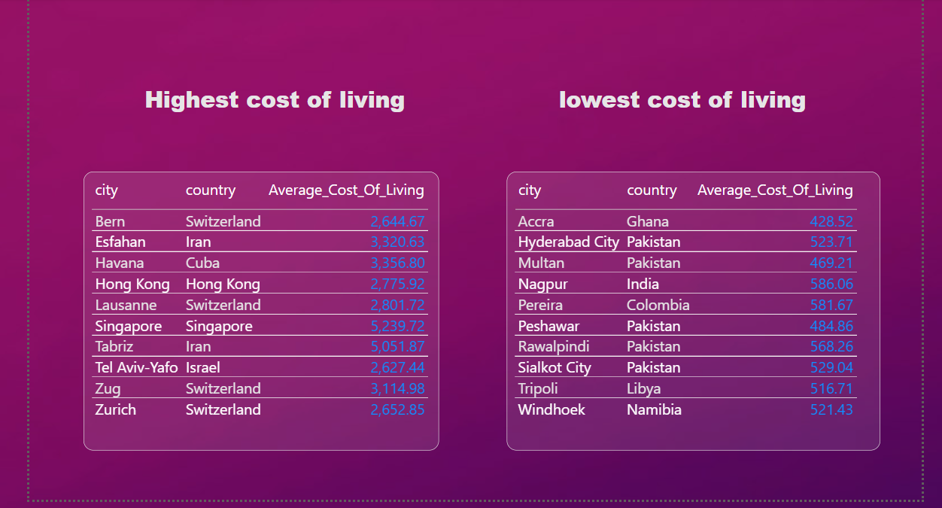
1 - What are the cities and countries with the highest and lowest costs of living?

Slide 8
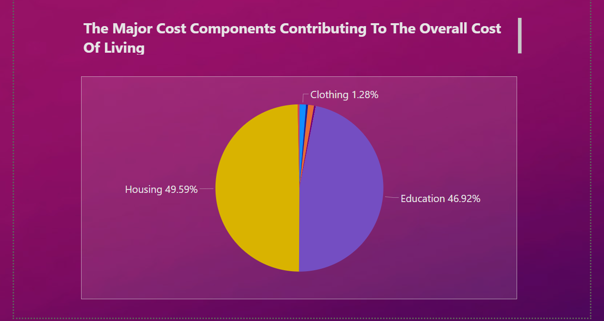
2 - What are the major cost components contributing to the overall cost of living in a region?

Slide 9
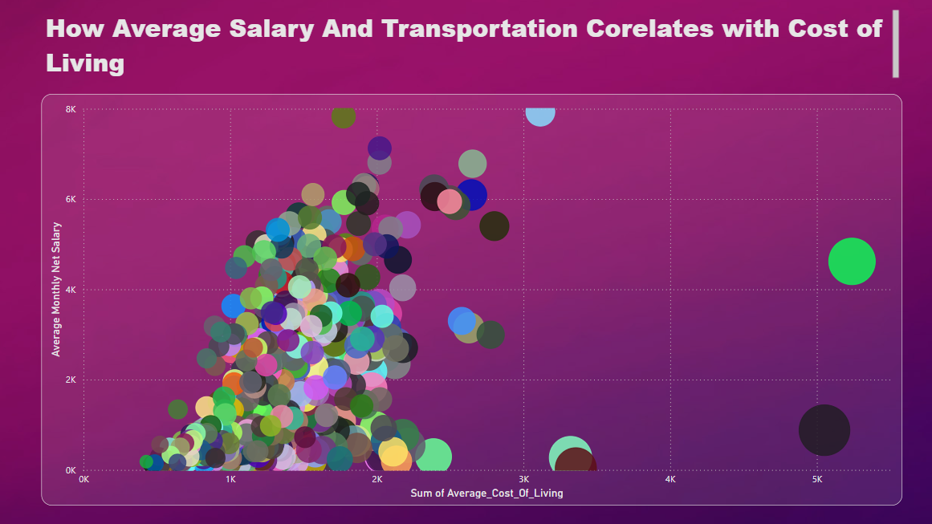
3 – How do factors like average salary, housing costs, and transportation expenses correlate with the cost of living? (A)

Slide 10
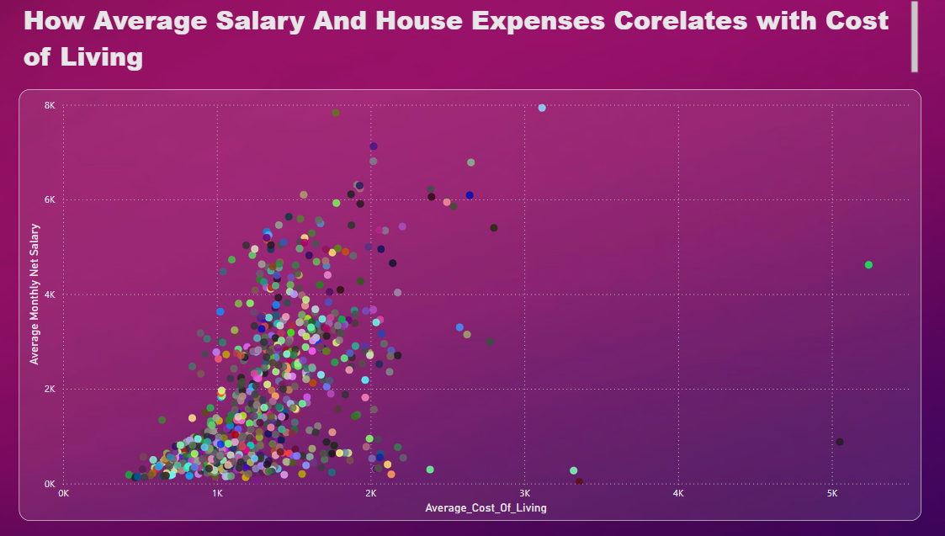
(B)

Slide 11
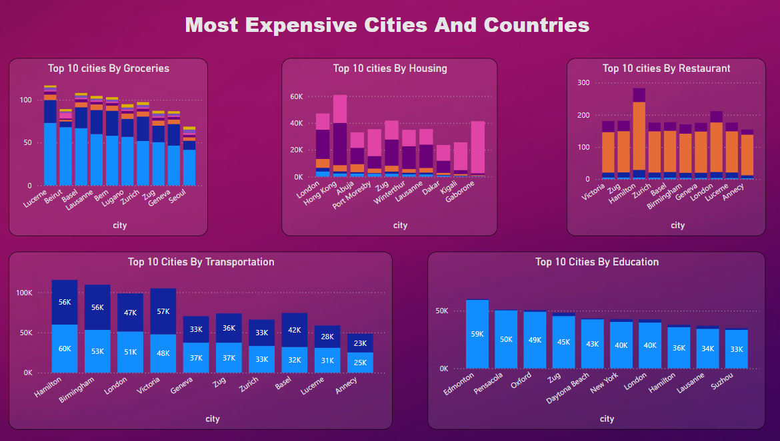
4 - Are there any trends or patterns in the data that can help individuals and organizations make strategic decisions? (A)

Slide 12
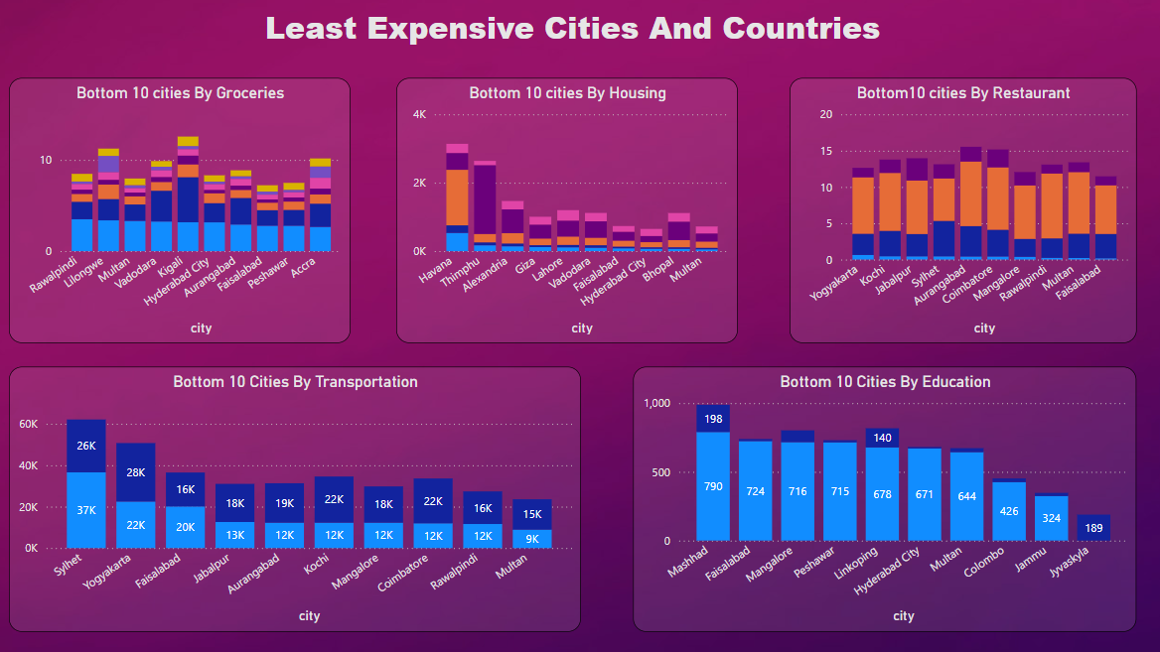
(B)

Slide 13
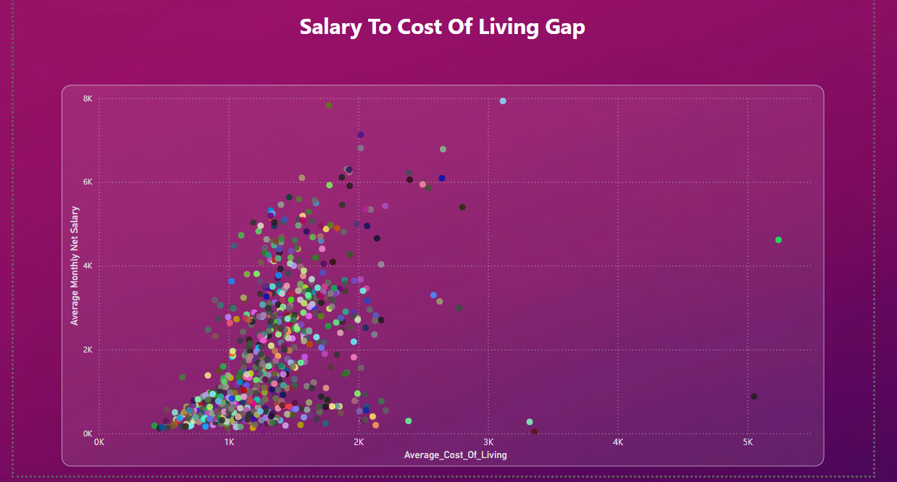
(C)

Slide 14
Thank you
Thakur Aryan Singh
singharya2004@gmail.com
Batch Name: MIP-DA-08

